Slide 1
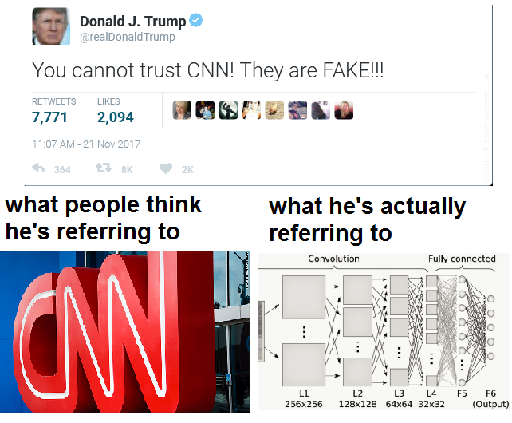
From statsmemes @ facebook (Thanks Adi!)
Notes:
delete after 2017

Slide 2
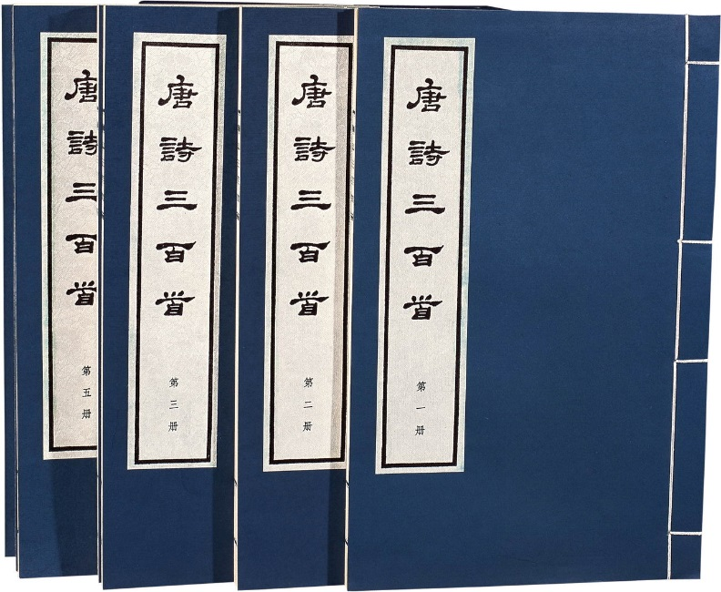












Generation
Writing Poems?
Drawing?
Notes:
就像教小朋友畫圖

Slide 3

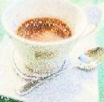
Review: Auto-encoder
As close as possible
NN
Encoder
NN
Decoder
code
Randomly generate a vector as code
NN
Decoder
code
Image ?

Slide 4
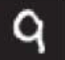
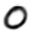
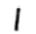
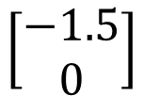
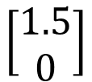
Review: Auto-encoder
2D
NN
Decoder
code
NN
Decoder
$$\left[\begin{aligned}1.5 \\ 0\end{aligned}\right]$$
-1.5
1.5
$$\left[\begin{aligned}−1.5 \\ 0\end{aligned}\right]$$
NN
Decoder
Notes:
SOM: http://alaric-research.blogspot.tw/2011/02/self-organizing-map.html

Slide 5
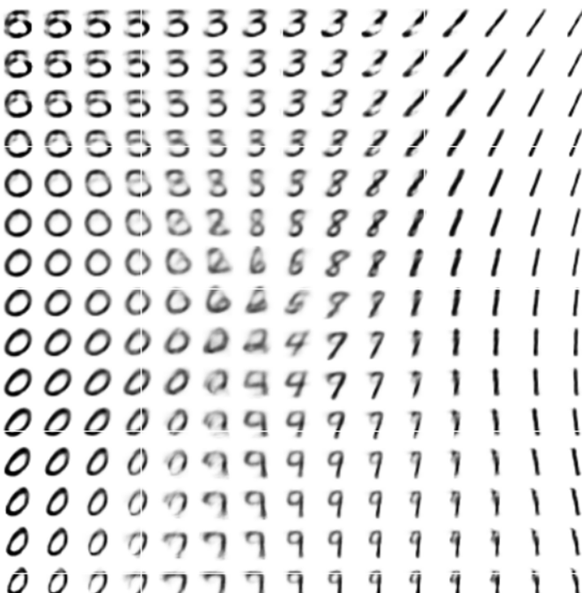
Review: Auto-encoder
-1.5
1.5
Notes:
SOM: http://alaric-research.blogspot.tw/2011/02/self-organizing-map.html

Slide 6
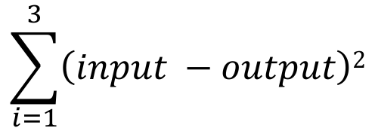
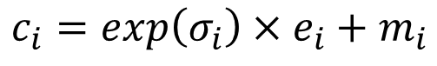
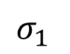
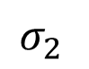
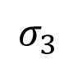
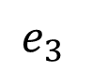
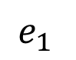
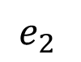
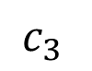
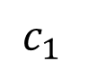
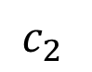
Auto-encoder
NN
Encoder
NN
Decoder
input
output
code
VAE
Minimize reconstruction error
m₁
m₂
NN
Encoder
m₃
$$c_{1}$$
input
NN
Decoder
$$σ_{1}$$
exp
+
$$c_{2}$$
output
$$σ_{2}$$
$$c_{3}$$
$$σ_{3}$$
X
$$c_{i}=exp\left(σ_{i}\right)×e_{i}+m_{i}$$
$$e_{1}$$
From a normal distribution
$$e_{2}$$
Minimize
$$e_{3}$$
$$\sum_{i=1}^{3}{\left(input −output\right)2}$$

Slide 7
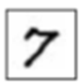
Problems of Auto-Encoders
It does not really try to simulate real images
code
NN
Decoder
Output
As close as possible
One pixel difference from the target
One pixel difference from the target
Realistic
Fake

Slide 8
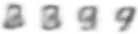
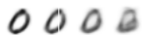
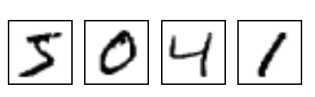
The evolution of generation
NN
Generator
v1
NN
Generator
v2
NN
Generator
v3
Discri-minator
v1
Discri-minator
v2
Discri-minator
v3
Binary
Classifier
Real images:

Slide 9
The evolution of generation
NN
Generator
v1
NN
Generator
v2
NN
Generator
v3
Discri-minator
v1
Discri-minator
v2
Discri-minator
v3
Real images:
Notes:
Binary
Classifier

Slide 10
GAN - Discriminator
NN
Generator
v1
Randomly sample a vector
0
0
0
0
Something like Decoder in VAE
Real images:
1
1
1
1
image
Discri-minator
v1
(real or fake)
1/0

Slide 11
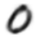
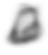
GAN - Generator
Randomly sample a vector
NN
Generator
v1
Updating the parameters of generator
v2
The output be classified as “real” (as close to 1 as possible)
Generator + Discriminator = a network
Discri-minator
v1
Using gradient descent to update the parameters in the generator, but fix the discriminator
1.0
0.13

Slide 12
GAN – 二次元人物頭像鍊成
Source of images: https://zhuanlan.zhihu.com/p/24767059
DCGAN: https://github.com/carpedm20/DCGAN-tensorflow

Slide 13
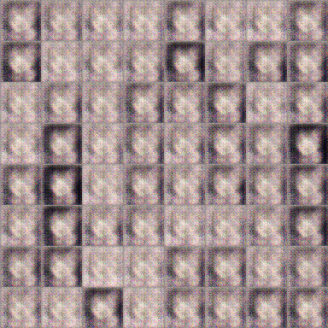
GAN – 二次元人物頭像鍊成
100 rounds

Slide 14
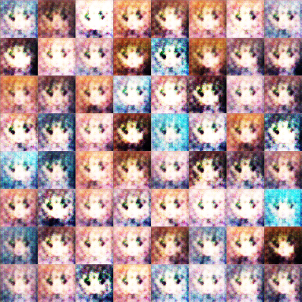
GAN – 二次元人物頭像鍊成
1000 rounds

Slide 15
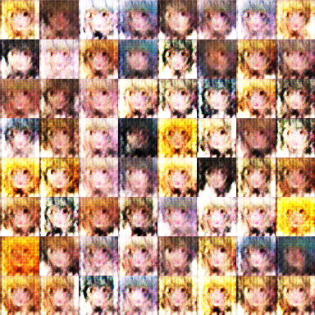
GAN – 二次元人物頭像鍊成
2000 rounds

Slide 16
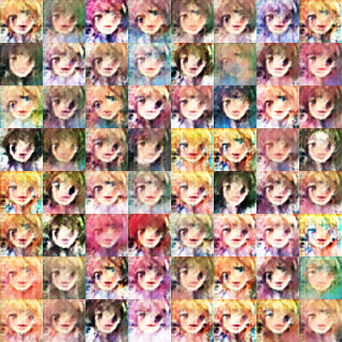
GAN – 二次元人物頭像鍊成
5000 rounds

Slide 17
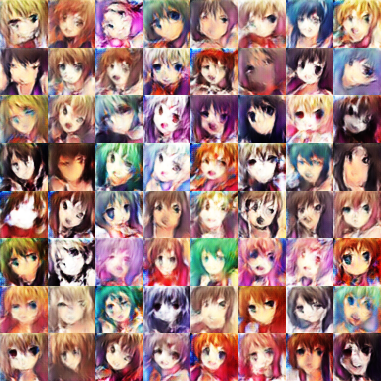
GAN – 二次元人物頭像鍊成
10,000 rounds

Slide 18
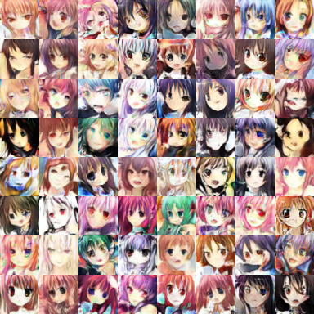
GAN – 二次元人物頭像鍊成
20,000 rounds

Slide 19
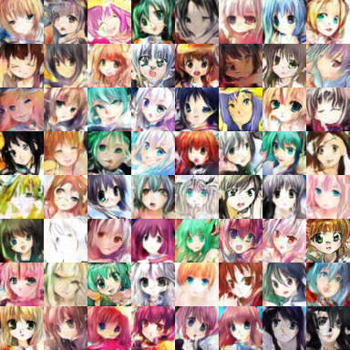
GAN – 二次元人物頭像鍊成
50,000 rounds

Slide 20
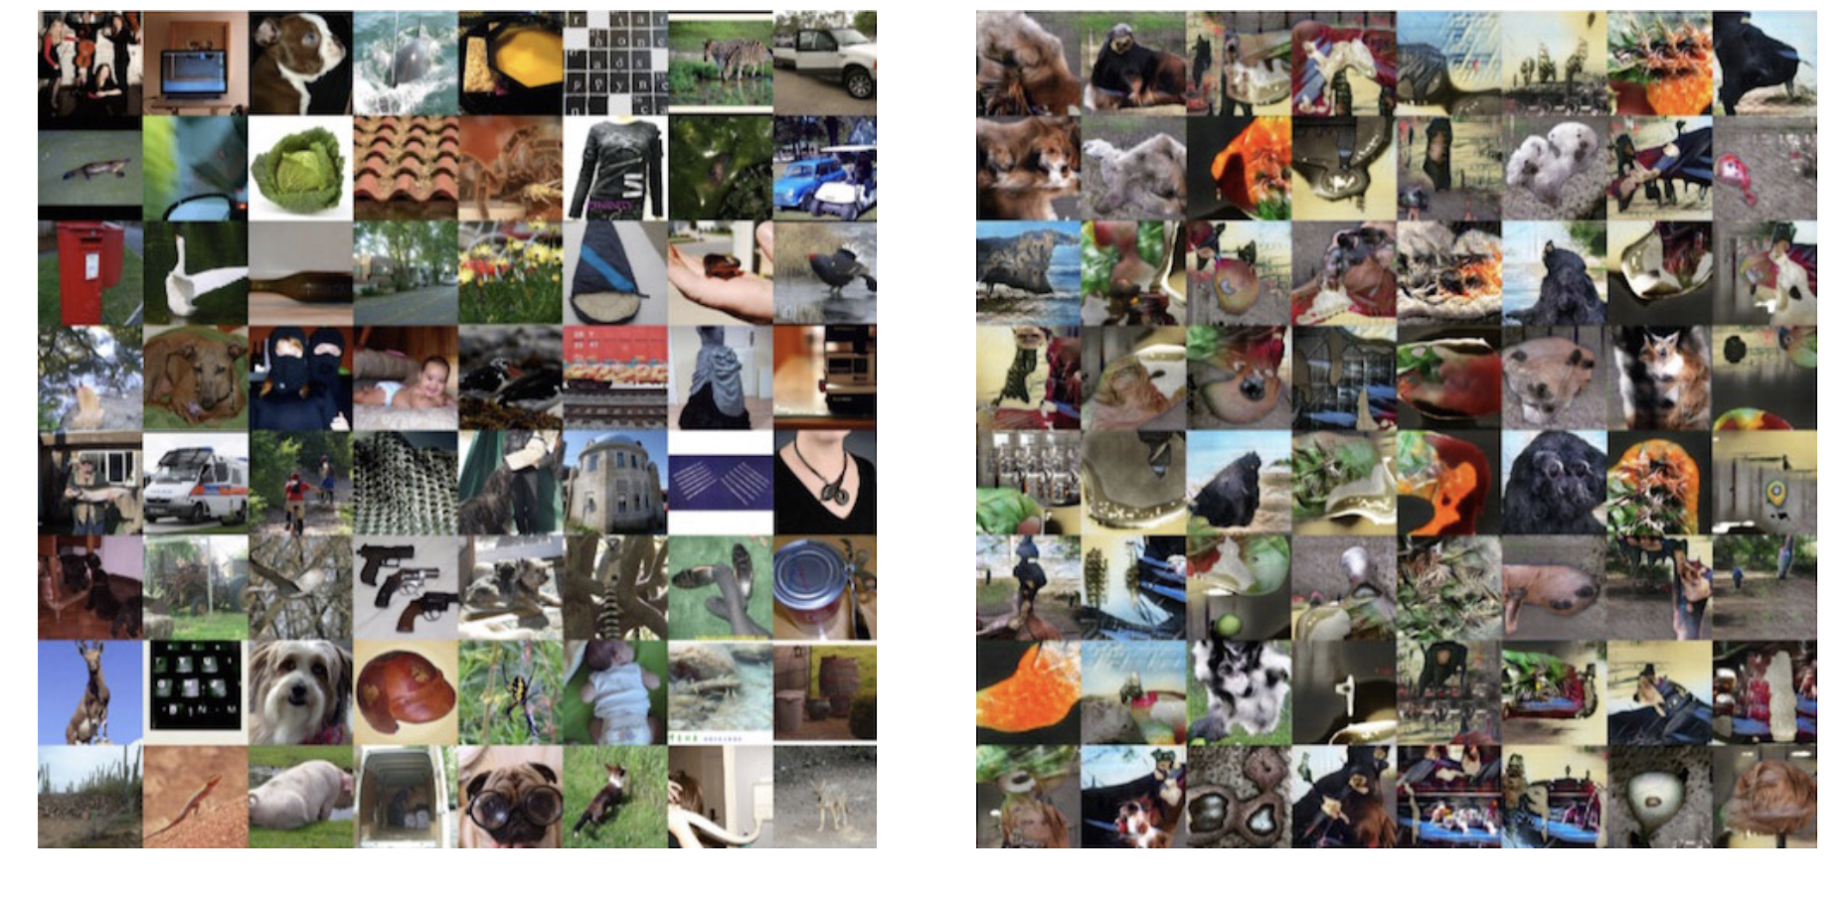
From: https://blog.openai.com/generative-models/

Slide 21
https://www.youtube.com/watch?v=Khuj4ASldmU

Slide 22
Basic Idea of GAN

Slide 23
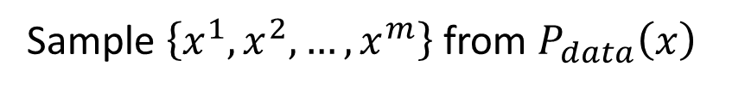
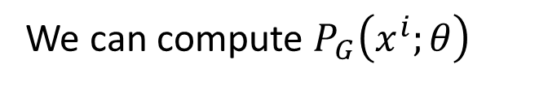
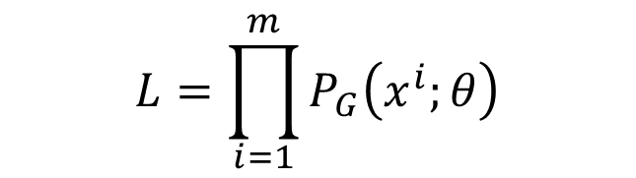

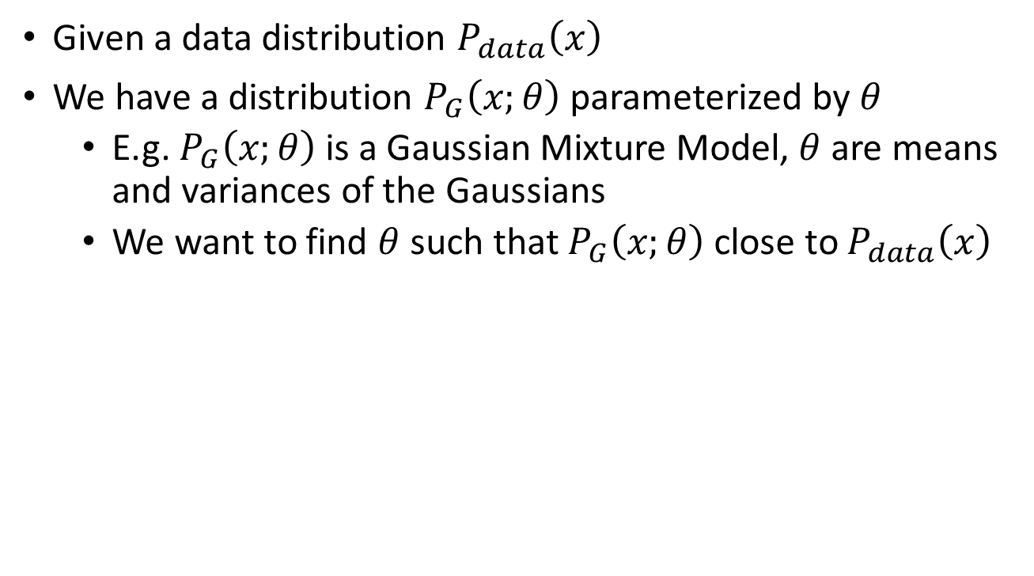
Maximum Likelihood Estimation
Given a data distribution $P_{data}\left(x\right)$
We have a distribution $P_{G}\left(x;θ\right)$ parameterized by $θ$
E.g. $P_{G}\left(x;θ\right)$ is a Gaussian Mixture Model, $θ$ are means and variances of the Gaussians
We want to find $θ$ such that $P_{G}\left(x;θ\right)$ close to $P_{data}\left(x\right)$
Sample $\left\{x^{1},x^{2},…,x^{m}\right\}$ from $P_{data}\left(x\right)$
We can compute $P_{G}\left(x^{i};θ\right)$
Likelihood of generating the samples
$$L=\prod_{i=1}^{m}{P_{G}\left(x^{i};θ\right)}$$
Find $θ^{∗}$ maximizing the likelihood

Slide 24
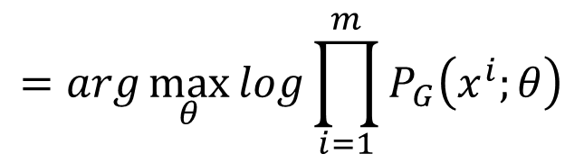
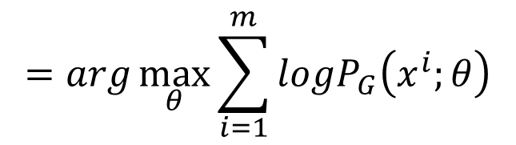
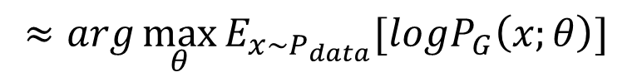
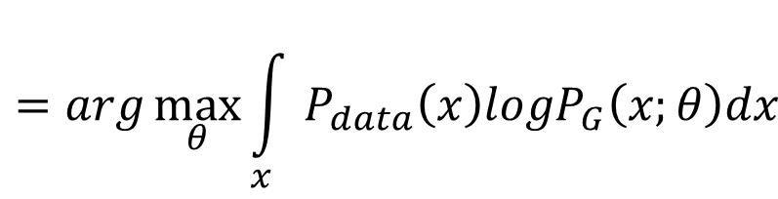
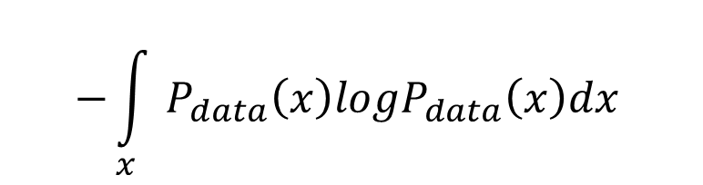
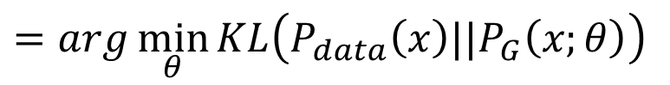
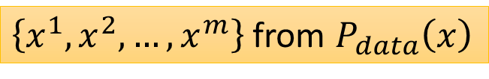
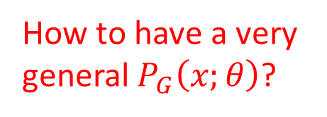
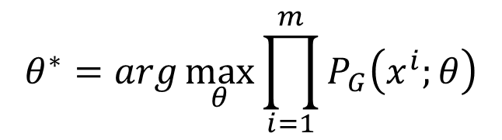
Maximum Likelihood Estimation
$$θ^{∗}=arg\max_{θ}{\prod_{i=1}^{m}{P_{G}\left(x^{i};θ\right)}}$$
$$=arg\max_{θ}{log\prod_{i=1}^{m}{P_{G}\left(x^{i};θ\right)}}$$
$$=arg\max_{θ}{\sum_{i=1}^{m}{logP_{G}\left(x^{i};θ\right)}}$$
$\left\{x^{1},x^{2},…,x^{m}\right\}$ from $P_{data}\left(x\right)$
$$≈arg\max_{θ}{E_{x\sim P_{data}}[logP_{G}\left(x;θ\right)] }$$
$$=arg\max_{θ}{\int_{x}{P_{data}\left(x\right)logP_{G}\left(x;θ\right)dx} }$$
$$−{\int_{x}{P_{data}\left(x\right)logP_{data}\left(x\right)dx} }$$
How to have a very general $P_{G}\left(x;θ\right)$?
$$=arg\min_{θ}{KL\left(P_{data}\left(x\right)||P_{G}\left(x;θ\right)\right) }$$

Slide 25
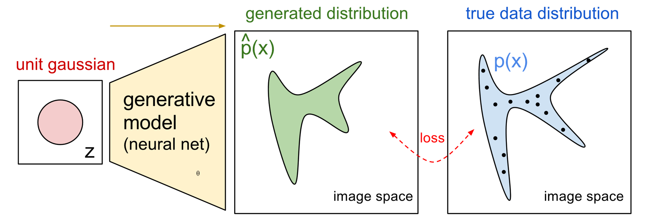
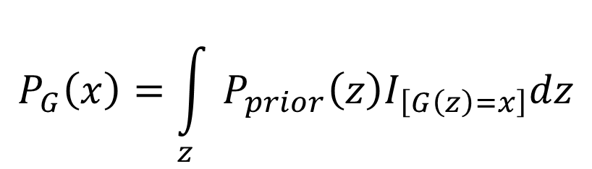
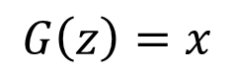




Now $P_{G}\left(x;θ\right)$ is a NN
$$P_{G}\left(x;θ\right)$$
$$P_{data}\left(x\right)$$
$$G\left(z\right)=x$$
$$x$$
$$P_{G}\left(x\right)=\int_{z}{P_{prior}\left(z\right)I_{\left[G\left(z\right)=x\right]}dz}$$
It is difficult to compute the likelihood.
https://blog.openai.com/generative-models/

Slide 26

Basic Idea of GAN
Generator G
G is a function, input z, output x
Given a prior distribution P_{prior}(z), a probability distribution P_{G}(x) is defined by function G
Discriminator D
D is a function, input x, output scalar
Evaluate the “difference” between P_{G}(x) and P_{data}(x)
There is a function V(G,D).
Hard to learn by maximum likelihood
$$G^{∗}=arg\min_{G}{\max_{D}{V\left(G,D\right)}}$$

Slide 27











Basic Idea
$$G^{∗}=arg\min_{G}{\max_{D}{V\left(G,D\right)}}$$
$$V=E_{x∼P_{data}}\left[logD\left(x\right)\right]+E_{x∼P_{G}}\left[log\left(1−D\left(x\right)\right)\right]$$
Given a generator G, $\max_{D}{V\left(G,D\right)}$ evaluate the “difference” between $P_{G}$ and $P_{data}$
Pick the G defining $P_{G}$ most similar to $P_{data}$
$$V\left(G_{1} ,D\right)$$
$$V\left(G_{2} ,D\right)$$
$$V\left(G_{3} ,D\right)$$
$$D$$
$$D$$
$$D$$
$$G_{1}$$
$$G_{2}$$
$$G_{3}$$

Slide 28




$$\max_{D}{V\left(G,D\right)}$$
$$G^{∗}=arg\min_{G}{\max_{D}{V\left(G,D\right)}}$$
Given G, what is the optimal D* maximizing
Given x, the optimal D* maximizing
$$V=E_{x∼P_{data}}\left[logD\left(x\right)\right]+E_{x∼P_{G}}\left[log\left(1−D\left(x\right)\right)\right]$$
$$=\int_{x}{P_{data}\left(x\right)logD\left(x\right)}dx+\int_{x}{P_{G}\left(x\right)log\left(1−D\left(x\right)\right)}dx$$
$$=\int_{x}{\left[P_{data}\left(x\right)logD\left(x\right)+P_{G}\left(x\right)log\left(1−D\left(x\right)\right)\right]}dx$$
Assume that D(x) can have any value here
$$P_{data}\left(x\right)logD\left(x\right)+P_{G}\left(x\right)log\left(1−D\left(x\right)\right)$$

Slide 29








$$\max_{D}{V\left(G,D\right)}$$
$$G^{∗}=arg\min_{G}{\max_{D}{V\left(G,D\right)}}$$
Given x, the optimal D* maximizing
Find D* maximizing:
$$P_{data}\left(x\right)logD\left(x\right)+P_{G}\left(x\right)log\left(1−D\left(x\right)\right)$$
a
D
b
D
$$f\left(D\right)=alog(D)+blog\left(1−D\right)$$
$$\frac{df\left(D\right)}{dD}=a×\frac{1}{D}+b×\frac{1}{1−D}×\left(−1\right)$$
$$=0$$
$$a×\frac{1}{D^{∗}}=b×\frac{1}{1−D^{∗}}$$
$$a×\left(1−D^{∗}\right)=b×D^{∗}$$
$$a−aD^{∗}=bD^{∗}$$
$$D^{∗}=\frac{a}{a+b}$$
$$D^{∗}\left(x\right)=\frac{P_{data}\left(x\right)}{P_{data}\left(x\right)+P_{G}\left(x\right)}$$
0 <
< 1
Notes:
sigmoid

Slide 30










$$\max_{D}{V\left(G,D\right)}$$
$$G^{∗}=arg\min_{G}{\max_{D}{V\left(G,D\right)}}$$
$$D_{1}^{∗}\left(x\right)=\frac{P_{data}\left(x\right)}{P_{data}\left(x\right)+P_{G_{1}}\left(x\right)}$$
$$D_{2}^{∗}\left(x\right)=\frac{P_{data}\left(x\right)}{P_{data}\left(x\right)+P_{G_{2}}\left(x\right)}$$
“difference” between $P_{G_{1}}$ and $P_{data}$
$$V\left(G_{1} ,D_{1}^{∗}\right)$$
$$D$$
$$D$$
$$D$$
$$V\left(G_{1} ,D\right)$$
$$V\left(G_{2} ,D\right)$$
$$V\left(G_{3} ,D\right)$$

Slide 31













$$\max_{D}{V\left(G,D\right)}$$
$$V=E_{x∼P_{data}}\left[logD\left(x\right)\right]$$
$$+E_{x∼P_{G}}\left[log\left(1−D\left(x\right)\right)\right]$$
$$\max_{D}{V\left(G,D\right)}$$
$$=V\left(G,D^{∗}\right)$$
$$D^{∗}\left(x\right)=\frac{P_{data}\left(x\right)}{P_{data}\left(x\right)+P_{G}\left(x\right)}$$
$$=E_{x∼P_{data}}\left[log\frac{P_{data}\left(x\right)}{P_{data}\left(x\right)+P_{G}\left(x\right)}\right]$$
$$+E_{x∼P_{G}}\left[log\frac{P_{G}\left(x\right)}{P_{data}\left(x\right)+P_{G}\left(x\right)}\right]$$
$$\frac{1}{2}$$
$$=\int_{x}{P_{data}\left(x\right)log\frac{P_{data}\left(x\right)}{P_{data}\left(x\right)+P_{G}\left(x\right)}}dx$$
$$\frac{1}{2}$$
2
$$+\int_{x}{P_{G}\left(x\right)log\frac{P_{G}\left(x\right)}{P_{data}\left(x\right)+P_{G}\left(x\right)}}dx$$
$$+2log\frac{1}{2}$$
$$−2log2$$
2
Notes:
Converge

Slide 32






$$\max_{D}{V\left(G,D\right)}$$
$$\max_{D}{V\left(G,D\right)}$$
$$=V\left(G,D^{∗}\right)$$
$$D^{∗}\left(x\right)=\frac{P_{data}\left(x\right)}{P_{data}\left(x\right)+P_{G}\left(x\right)}$$
$$=−2log2+\int_{x}{P_{data}\left(x\right)log\frac{P_{data}\left(x\right)}{\left(P_{data}\left(x\right)+P_{G}\left(x\right)\right)/2}}dx$$
$$+\int_{x}{P_{G}\left(x\right)log\frac{P_{G}\left(x\right)}{\left(P_{data}\left(x\right)+P_{G}\left(x\right)\right)/2}}dx$$
$$=−2log2+KL\left(P_{data}\left(x\right)||\frac{P_{data}\left(x\right)+P_{G}\left(x\right)}{2}\right)$$
$$+KL\left(P_{G}\left(x\right)||\frac{P_{data}\left(x\right)+P_{G}\left(x\right)}{2}\right)$$
$$=−2log2+2JSD\left(P_{data}\left(x\right)||P_{G}\left(x\right)\right)$$
Jensen-Shannon divergence

Slide 33



In the end ……
$$V=E_{x∼P_{data}}\left[logD\left(x\right)\right]$$
$$+E_{x∼P_{G}}\left[log\left(1−D\left(x\right)\right)\right]$$
Generator G, Discriminator D
Looking for G* such that
Given G, $\max_{D}{V\left(G,D\right)}$
What is the optimal G?
$$G^{∗}=arg\min_{G}{\max_{D}{V\left(G,D\right)}}$$
0 <
< log 2
$$=−2log2+2JSD\left(P_{data}\left(x\right)||P_{G}\left(x\right)\right)$$
$$P_{G}\left(x\right)=P_{data}\left(x\right)$$

Slide 34















Algorithm
$$G^{∗}=arg\min_{G}{\max_{D}{V\left(G,D\right)}}$$
$$L\left(G\right)$$
To find the best G minimizing the loss function $L\left(G\right)$,
$$θ_{G}←θ_{G}−η{∂L\left(G\right)}/{∂θ_{G}}$$
$θ_{G}$ defines G
$$\frac{df\left(x\right)}{dx}=?$$
$${dD_{i}\left(x\right)}/{dx}$$
$$f\left(x\right)=max⁡\{D_{1}\left(x\right),D_{2}\left(x\right),D_{3}\left(x\right)\}$$
If $D_{i}\left(x\right)$ is the max one
$$D_{1}\left(x\right)$$
$$D_{3}\left(x\right)$$
$$D_{2}\left(x\right)$$
$${dD_{1}\left(x\right)}/{dx}$$
$${dD_{2}\left(x\right)}/{dx}$$
$${dD_{3}\left(x\right)}/{dx}$$

Slide 35



Algorithm
$$G^{∗}=arg\min_{G}{\max_{D}{V\left(G,D\right)}}$$
$$L\left(G\right)$$
Given $G_{0}$
Find $D_{0}^{∗}$ maximizing $V\left(G_{0},D\right)$
$θ_{G}←θ_{G}−η{∂V\left(G,D_{0}^{∗}\right)}/{∂θ_{G}}$ Obtain $G_{1}$
Find $D_{1}^{∗}$ maximizing $V\left(G_{1},D\right)$
$θ_{G}←θ_{G}−η{∂V\left(G,D_{1}^{∗}\right)}/{∂θ_{G}}$ Obtain $G_{2}$
……
$V\left(G_{0},D_{0}^{∗}\right)$ is the JS divergence between $P_{data}\left(x\right)$ and $P_{G_{0}}\left(x\right)$
Decrease JS divergence(?)
$V\left(G_{1},D_{1}^{∗}\right)$ is the JS divergence between $P_{data}\left(x\right)$ and $P_{G_{1}}\left(x\right)$
Decrease JS divergence(?)

Slide 36









Algorithm
$$G^{∗}=arg\min_{G}{\max_{D}{V\left(G,D\right)}}$$
$$L\left(G\right)$$
Given $G_{0}$
Find $D_{0}^{∗}$ maximizing $V\left(G_{0},D\right)$
$θ_{G}←θ_{G}−η{∂V\left(G,D_{0}^{∗}\right)}/{∂θ_{G}}$ Obtain $G_{1}$
$V\left(G_{0},D_{0}^{∗}\right)$ is the JS divergence between $P_{data}\left(x\right)$ and $P_{G_{0}}\left(x\right)$
Decrease JS divergence(?)
$$V\left(G_{0} ,D_{0}^{∗} \right)$$
smaller
$$V\left(G_{1} ,D_{0}^{∗} \right)$$
……
$$V\left(G_{1} ,D_{1}^{∗} \right)$$
Assume $D_{0}^{∗}≈D_{1}^{∗}$
$$D_{0}^{∗}$$
$$D_{0}^{∗}$$
Don’t update G too much
$$V\left(G_{0} ,D\right)$$
$$V\left(G_{1} ,D\right)$$
Notes:
這頁對嗎？

Slide 37


In practice …
$$V=E_{x∼P_{data}}\left[logD\left(x\right)\right]$$
$$+E_{x∼P_{G}}\left[log\left(1−D\left(x\right)\right)\right]$$
Given G, how to compute $\max_{D}{V\left(G,D\right)}$
Sample $\left\{x^{1},x^{2},…,x^{m}\right\}$ from $P_{data}\left(x\right)$, sample $\left\{{\tilde{x}}^{1},{\tilde{x}}^{2},…,{\tilde{x}}^{m}\right\}$ from generator $P_{G}\left(x\right)$
$$\tilde{V}=\frac{1}{m}\sum_{i=1}^{m}{logD\left(x^{i}\right)}+\frac{1}{m}\sum_{i=1}^{m}{log\left(1−D\left({\tilde{x}}^{i}\right)\right)}$$
Maximize
Binary Classifier
Output is D(x)
Minimize Cross-entropy
If x is a positive example
Minimize –log D(x)
If x is a negative example
Minimize –log(1-D(x))

Slide 38





Binary Classifier
Output is f(x)
Minimize Cross-entropy
If x is a positive example
Minimize –log f(x)
If x is a negative example
Minimize –log(1-f(x))
D is a binary classifier (can be deep) with parameters $θ_{d}$
$\left\{x^{1},x^{2},…,x^{m}\right\}$ from $P_{data}\left(x\right)$
Positive examples
$\left\{{\tilde{x}}^{1},{\tilde{x}}^{2},…,{\tilde{x}}^{m}\right\}$ from $P_{G}\left(x\right)$
Negative examples
$$L=\frac{1}{m}\sum_{i=1}^{m}{logD\left(x^{i}\right)}+\frac{1}{m}\sum_{i=1}^{m}{log\left(1−D\left({\tilde{x}}^{i}\right)\right)}$$
Minimize
$$=$$
$$\tilde{V}=\frac{1}{m}\sum_{i=1}^{m}{logD\left(x^{i}\right)}+\frac{1}{m}\sum_{i=1}^{m}{log\left(1−D\left({\tilde{x}}^{i}\right)\right)}$$
Maximize

Slide 39



Initialize $θ_{d}$ for D and $θ_{g}$ for G
Algorithm
Can only find lower found of
$$\max_{D}{V\left(G,D\right)}$$
In each training iteration:
Sample m examples $\left\{x^{1},x^{2},…,x^{m}\right\}$ from data distribution $P_{data}\left(x\right)$
Sample m noise samples $\left\{z^{1},z^{2},…,z^{m}\right\}$ from the prior $P_{prior}\left(z\right)$
Obtaining generated data $\left\{{\tilde{x}}^{1},{\tilde{x}}^{2},…,{\tilde{x}}^{m}\right\}$, ${\tilde{x}}^{i}=G\left(z^{i}\right)$
Update discriminator parameters $θ_{d}$ to maximize
$\tilde{V}=\frac{1}{m}\sum_{i=1}^{m}{logD\left(x^{i}\right)}+\frac{1}{m}\sum_{i=1}^{m}{log\left(1−D\left({\tilde{x}}^{i}\right)\right)}$
$θ_{d}←θ_{d}+η∇\tilde{V}\left(θ_{d}\right)$
Sample another m noise samples $\left\{z^{1},z^{2},…,z^{m}\right\}$ from the prior $P_{prior}\left(z\right)$
Update generator parameters $θ_{g}$ to minimize
$\tilde{V}=\frac{1}{m}\sum_{i=1}^{m}{logD\left(x^{i}\right)}+\frac{1}{m}\sum_{i=1}^{m}{log\left(1−D\left(G\left(z^{i}\right)\right)\right)}$
$θ_{g}←θ_{g}−η∇\tilde{V}\left(θ_{g}\right)$
Learning
D
Repeat k times
Learning
G
Only Once
Notes:
位什麼要 1- 啊

Slide 40







Objective Function for Generator in Real Implementation
$$V=E_{x∼P_{data}}\left[logD\left(x\right)\right]$$
$$−log\left(D\left(x\right)\right)$$
$$+E_{x∼P_{G}}\left[log\left(1−D\left(x\right)\right)\right]$$
Slow at the beginning
$$V=E_{x∼P_{G}}\left[−log\left(D\left(x\right)\right)\right]$$
$$D\left(x\right)$$
Real implementation:
label x from P_{G} as positive
$$log\left(1−D\left(x\right)\right)$$

Slide 41


Demo
The code used in demo from:
https://github.com/osh/KerasGAN/blob/master/MNIST_CNN_GAN_v2.ipynb
Notes:
http://140.112.21.35:6001/notebooks/GAN%20MNIST%20demo.ipynb
keras-adversarial
https://github.com/bstriner/keras-adversarial
https://github.com/ProofByConstruction/better-explanations/blob/master/experiments/generative-adversarial-nets/Simple%20GAN.ipynb
Simple example of TF version
I cannot run it, probably because of version issue

Slide 42
Issue about Evaluating the Divergence

Slide 43

Evaluating JS divergence
Martin Arjovsky, Léon Bottou, Towards Principled Methods for Training Generative Adversarial Networks, 2017, arXiv preprint

Slide 44


Evaluating JS divergence
https://arxiv.org/abs/1701.07875
JS divergence estimated by discriminator telling little information
Weak Generator
Strong Generator

Slide 45

Discriminator
1
0
$$V=E_{x∼P_{data}}\left[logD\left(x\right)\right]+E_{x∼P_{G}}\left[log\left(1−D\left(x\right)\right)\right]$$
$$≈\frac{1}{m}\sum_{i=1}^{m}{logD\left(x^{i}\right)}+\frac{1}{m}\sum_{i=1}^{m}{log\left(1−D\left({\tilde{x}}^{i}\right)\right)}$$
$$\max_{D}{V\left(G,D\right)}=−2log2+2JSD\left(P_{data}\left(x\right)||P_{G}\left(x\right)\right)$$
= 0
log2
Reason 1. Approximate by sampling
Weaken your discriminator?
Can weak discriminator compute JS divergence?

Slide 46

Discriminator
1
0
$$V=E_{x∼P_{data}}\left[logD\left(x\right)\right]+E_{x∼P_{G}}\left[log\left(1−D\left(x\right)\right)\right]$$
$$≈\frac{1}{m}\sum_{i=1}^{m}{logD\left(x^{i}\right)}+\frac{1}{m}\sum_{i=1}^{m}{log\left(1−D\left({\tilde{x}}^{i}\right)\right)}$$
$$\max_{D}{V\left(G,D\right)}=−2log2+2JSD\left(P_{data}\left(x\right)||P_{G}\left(x\right)\right)$$
= 0
log2
Reason 2. the nature of data
Both $P_{data}\left(x\right)$ and $P_{G}\left(x\right)$ are low-dim manifold in high-dim space
Usually they do not have any overlap

Slide 47

Evaluation
http://www.guokr.com/post/773890/
Better

Slide 48









Evaluation
$$P_{G_{0}}\left(x\right)$$
$$JS\left(P_{G_{1}}||P_{data}\right)=log2$$
$$P_{data}\left(x\right)$$
……
Better
$$P_{G_{50}}\left(x\right)$$
$$JS\left(P_{G_{2}}||P_{data}\right)=log2$$
$$P_{data}\left(x\right)$$
Not really better ……
……
$$P_{G_{100}}\left(x\right)$$
$$P_{data}\left(x\right)$$
$$JS\left(P_{G_{2}}||P_{data}\right)=0$$

Slide 49


Add Noise
Add some artificial noise to the inputs of discriminator
Make the labels noisy for the discriminator
Discriminator cannot perfectly separate real and generated data
$P_{data}\left(x\right)$ and $P_{G}\left(x\right)$ have some overlap
Noises decay over time

Slide 50
Mode Collapse

Slide 51

Mode Collapse
Generated Distribution
Data Distribution

Slide 52



Mode Collapse
$$P_{data}$$
What we want …
In reality …

Slide 53








Flaw in Optimization?
Modified from Ian Goodfellow’s tutorial
$$KL=\int{P_{data}log\frac{P_{data}}{P_{G}}dx}$$
Reverse $KL=\int{P_{G}log\frac{P_{G}}{P_{data}}dx}$
$$P_{data}$$
$$P_{data}$$
$$P_{G}$$
$$P_{G}$$
Maximum likelihood (minimize KL$(P_{data}||P_{G}$))
Minimize KL$(P_{G}||P_{data}$) (reverse KL)
This may not be the reason (based on Ian Goodfellow’s tutorial)

Slide 54
So many GANs ……
Modifying the Optimization of GAN
fGAN
WGAN
Least-square GAN
Loss Sensitive GAN
Energy-based GAN
Boundary-seeking GAN
Unroll GAN
……
Different Structure from the Original GAN
Conditional GAN
Semi-supervised GAN
InfoGAN
BiGAN
Cycle GAN
Disco GAN
VAE-GAN
……
Notes:
Application:
deep convolutional generative adversarial networks (DCGANs)

Slide 55
Conditional GAN

Slide 56
Motivation
Generator
Text
Image
Scott Reed, Zeynep Akata, Xinchen Yan, Lajanugen Logeswaran, Bernt Schiele, Honglak Lee, “Generative Adversarial Text-to-Image Synthesis”, ICML 2016
Han Zhang, Tao Xu, Hongsheng Li, Shaoting Zhang, Xiaolei Huang, Xiaogang Wang, Dimitris Metaxas, “StackGAN: Text to Photo-realistic Image Synthesis with Stacked Generative Adversarial Networks”, arXiv prepring, 2016
Scott Reed, Zeynep Akata, Santosh Mohan, Samuel Tenka, Bernt Schiele, Honglak Lee, “Learning What and Where to Draw”, NIPS 2016
Notes:
https://github.com/paarthneekhara/text-to-image

Slide 57








Motivation
Challenge
NN
(a point, not a distribution)
Text
Image
$$c$$
$$x$$
Text: “train”
NN output

Slide 58










Conditional GAN
Training data: $\left(\hat{c},\hat{x}\right)$
condition
G
Learn to approximate P(x|c)
$$c$$
$$x$$
Prior distribution
$$z$$
Learn to ignore this term …
$\left(\hat{c},x=G(\hat{c})\right)$ classified as positive
dropout
D (v1)
$$c$$
D (v2)
$$x$$
scalar
scalar
$$x$$
Can generated x not related to c
Positive example: $\left(\hat{c},\hat{x}\right)$
Negative example: $\left(\hat{c},G(\hat{c})\right),\left(\hat{c′},\hat{x}\right)$

Slide 59

Text to Image - Results

Slide 60


Text to Image - Results
"red flower with black center"

Slide 61
Image-to-image Translation
Phillip Isola, Jun-Yan Zhu, Tinghui Zhou, Alexei A. Efros, “Image-to-Image Translation with Conditional Adversarial Networks”, arXiv preprint, 2016
Notes:
Façade門面,正面,外觀,虛設的外表
That is the facade of the Palace. 那是宮殿的正面

Slide 63
Image-to-image Translation - Results

Slide 64
Speech Enhancement GAN
https://arxiv.org/abs/1703.09452

Slide 65
Speech Enhancement GAN
Using Least-square GAN

Slide 66


Least-square GAN
For discriminator
For Generator
D has linear output
$$\min_{D}{\frac{1}{2}E_{x\sim P_{data}}\left[{\left(D\left(x\right)−b\right)}^{2}\right]+\frac{1}{2}E_{x\sim P_{G}}\left[{\left(D\left(x\right)−a\right)}^{2}\right]}$$
1
0
$$\min_{D}{\frac{1}{2}E_{z\sim P_{data}}\left[{\left(D\left(G\left(z\right)\right)−c\right)}^{2}\right]}$$
1

Slide 67


Least-square GAN
The code used in demo from:
https://github.com/osh/KerasGAN/blob/master/MNIST_CNN_GAN_v2.ipynb
Notes:
http://140.112.21.35:6001/notebooks/GAN%20MNIST%20demo.ipynb
keras-adversarial
https://github.com/bstriner/keras-adversarial
https://github.com/ProofByConstruction/better-explanations/blob/master/experiments/generative-adversarial-nets/Simple%20GAN.ipynb
Simple example of TF version
I cannot run it, probably because of version issue

